Slide 1



Noida Institute of Engineering and Technology, Greater Noida
Probability and Random Variable
Unit: III
Subject Name: Mathematics-IV
Subject Code: AAS0402
Reeta Tyagi
Department of
Mathematics
B Tech 4th Sem

Slide 2

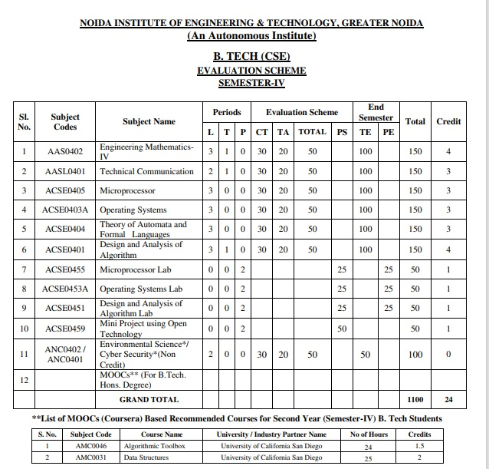
Evaluation Scheme

Slide 3
Syllabus
Unit-I (Statistical Techniques-I)
Introduction: Measures of central tendency: Mean, Median, Mode, Moment, Skewness, Kurtosis, Curve Fitting ,Method of least squares, Fitting of straight lines, Fitting of second degree parabola, Exponential curves ,Correlation and Rank correlation, Linear regression, nonlinear regression and multiple linear regression
Unit-II (Statistical Techniques-II)
Testing a Hypothesis, Null hypothesis, Alternative hypothesis, Level of significance, Confidence limits, p-value, Test of significance of difference of means, Z-test, t-test and Chi-square test, F-test, ANOVA: One way and Two way. Statistical Quality Control (SQC), Control Charts, Control Charts for variables (Mean and Range Charts), Control Charts for Variables ( p, np and C charts).

Slide 4
Syllabus
Unit III (Probability and Random Variable)
Random Variable: Definition of a Random Variable, Discrete Random Variable, Continuous Random Variable, Probability mass function, Probability Density Function, Distribution functions.
Multiple Random Variables: Joint density and distribution Function, Properties of Joint Distribution function, Marginal density Functions, Conditional Distribution and Density, Statistical Independence, Central Limit Theorem (Proof not expected).
Unit IV (Expectations and Probability Distribution)
Operation on One Random Variable – Expectations: Introduction, Expected Value of a Random Variable, Mean, Variance, Moment Generating Function, Binomial, Poisson, Normal, Exponential distribution.

Slide 5
Syllabus
Unit V (Wavelets and applications and Aptitude-IV)
Wavelet Transform, wavelet series. Basic wavelets (Haar/Shannon/Daubechies), orthogonal wavelets, multi-resolution analysis, reconstruction of wavelets and applications.
Number System, Permutation & Combination, Probability, Function, Data Interpretation, Syllogism.

Slide 6
Branch Wise Application
Data Analysis
Artificial intelligence
Network and Traffic modeling

Slide 7
Course Objectives
The objective of this course is to familiarize the students with statistical techniques. It aims to present the students with standard concepts and tools at an intermediate to superior level that will provide them well towards undertaking a variety of problems in the discipline.
The students will learn:
Understand the concept of correlation, moments, skewness and kurtosis and curve fitting.
Apply the concept of hypothesis testing and statistical quality control to create control charts.
Remember the concept of probability to evaluate probability distributions.
Understand the concept of Mathematical Expectations and Probability Distribution.
Remember the concept of Wavelet Transform and Solve the problems of Number System, Permutation & Combination, Probability, Function, Data Interpretation, Syllogism.

Slide 8
Course Outcomes
CO1: Understand the concept of correlation, moments, skewness and kurtosis and curve fitting.
CO2: Apply the concept of hypothesis testing and statistical quality control to create control charts.
CO3: Remember the concept of probability to evaluate probability distributions
CO4: Understand the concept of Mathematical Expectations and Probability Distribution
CO5: Remember the concept of Wavelet Transform and Solve the problems of Number System, Permutation & Combination, Probability, Function, Data Interpretation, Syllogism.

Slide 9
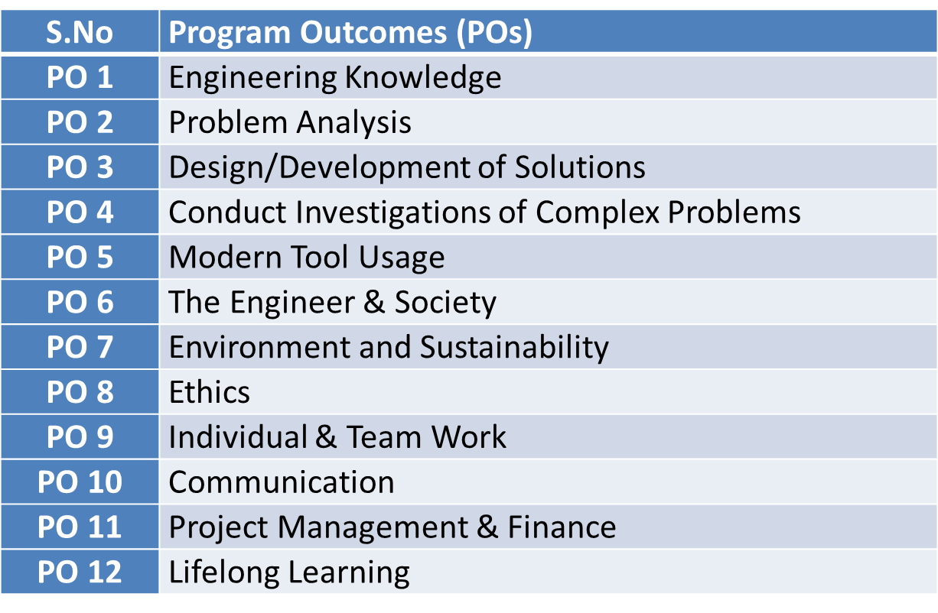
Program Outcomes

Slide 10
PSOs
PSO | Program Specific Outcomes(PSOs)
PSO1 | The ability to identify, analyze real world problems and design their ethical solutions using artificial intelligence, robotics, virtual/augmented reality, data analytics, block chain technology, and cloud computing
PSO2 | The ability to design and develop the hardware sensor devices and related interfacing software systems for solving complex engineering problems.
PSO3 | The ability to understand inter disciplinary computing techniques and to apply them in the design of advanced computing.
PSO4 | The ability to conduct investigation of complex problem with the help of technical, managerial, leadership qualities, and modern engineering tools provided by industry sponsored laboratories.

Slide 11
CO-PO Mapping
Sr. No | Course Outcome | PO1 | PO2 | PO3 | PO4 | PO5 | PO6 | PO7 | PO8 | PO9 | PO10 | PO11 | PO12
1 | CO1 | H | H | H | H | L | L | L | L | L | L | L | M
2 | CO2 | H | H | H | H | L | L | L | L | L | L | M | M
3 | CO3 | H | H | H | H | L | L | L | L | L | L | M | M
4 | CO4 | H | H | H | H | L | L | L | L | L | L | L | M
5 | CO5 | H | H | H | H | L | L | L | L | L | L | M | M
*L= Low *M= Medium *H= High

Slide 12
CO-PSO Mapping
CO | PSO1 | PSO2 | PSO3 | PSO4
CO.1 | H | L | M | L
CO.2 | L | M | L | M
CO.3 | M | M | M | M
CO.4 | H | M | M | M
CO.5 | H | M | M | M
*L= Low *M= Medium *H= High

Slide 13
Program Educational Objectives(PEOs)
PEO-1: To have an excellent scientific and engineering breadth so as to comprehend, analyze, design and provide sustainable solutions for real-life problems using state-of-the-art technologies.
PEO-2: To have a successful career in industries, to pursue higher studies or to support entrepreneurial endeavors and to face the global challenges.
PEO-3: To have an effective communication skills, professional attitude, ethical values and a desire to learn specific knowledge in emerging trends, technologies for research, innovation and product development and contribution to society.
PEO-4: To have life-long learning for up-skilling and re-skilling for successful professional career as engineer, scientist, entrepreneur and bureaucrat for betterment of society.

Slide 14
Result Analysis
Branch | Semester | Sections | No. of enrolled Students | No. Passed Students | % Passed
CS | IV | A | 67 | 67 | 100
IOT | IV | A | 49 | 45 | 91.83%

Slide 15
End Semester Question Paper Template
Link:100 Marks Question Paper Template.docx

Slide 16
Prerequisite and Recap (CO3)
Knowledge of Maths 1 B.Tech.
Knowledge of Maths 2 B.Tech.
Knowledge of Permutation and Combination.

Slide 17
Brief Introduction about the Subject with Videos (CO3)
We will discuss properties of complex function (limits, continuity, differentiability, Analyticity and integration)
In 3rd module we will discuss application of partial differential equations
In 4th module we will discuss numerical methods for solving algebraic equations, system of linear equations, definite integral and 1st order ordinary differential equation.
In 5th module we will discuss aptitude part.
https://youtu.be/iUhwCfz18os
https://youtu.be/ly4S0oi3Yz8
https://youtu.be/f8XzF9_2ijs

Slide 18
Unit Objectives (CO3)
A basic knowledge of random variables.
The student is able to reflect developed mathematical methods in probability and random variable.
Understand the concept of random variable.
4. To explore the key properties: such as PMF, PDF etc.

Slide 19
Topic Objective(CO3)
The random variable is very much helpful for making prediction. Estimates and predictions form an important part of research investigation. With the help of statistical methods, we make estimates for the further analysis.

Slide 20
Prerequisite and Recap (CO3)
Knowledge of combination
Knowledge of permutation
Some basic concepts of set theory.
Knowledge of determine Probability of events.
Dr. Anil Agarwal Maths IV Unit-III

Slide 21
Random Variable(CO3)
Definition: A particular value which cannot be predicated in advance then the value is called random variable.
There are two types of Random Variable.
Discrete Random variable: isolated values is known as discrete random variables.
Example: By tossing a coin 4 times, the number of Heads come up then the value of random variables are 0,1,2,3,4.
Continuous Random Variable: which variables can assume any value within interval is called continuous .
Example : the heights of a group of individuals, Weight of the students in a class etc.
Dr. Anil Agarwal Maths IV(AAS0402) Unit-III

Slide 22
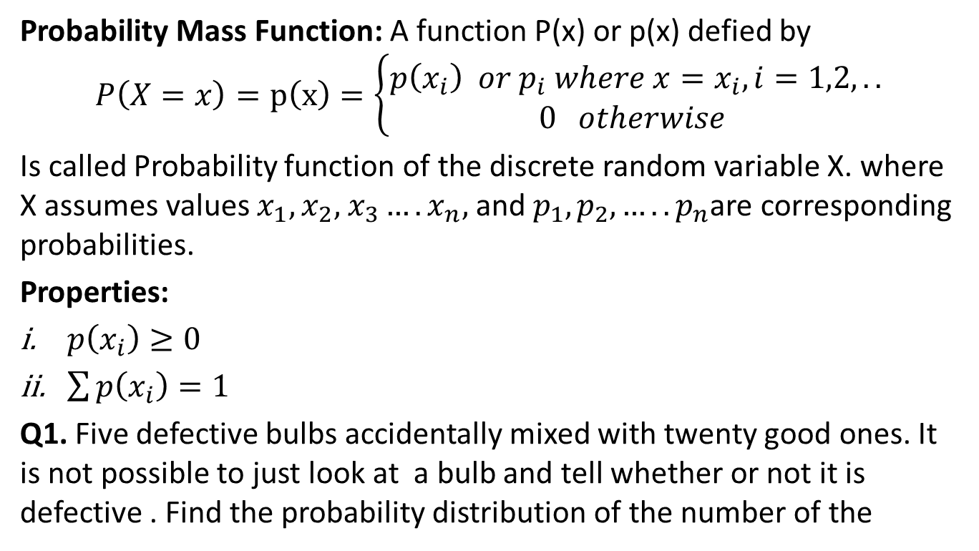
Probability Mass Function(CO3)
Probability Mass Function: A function P(x) or p(x) defied by
$$P\left(X=x\right)=p\left(x\right)=\left\{\begin{matrix}p\left(x_{i}\right) or p_{i} where x=x_{i},i=1,2,.. \\ 0 otherwise \end{matrix}\right.$$
Is called Probability function of the discrete random variable X. where X assumes values $x_{1},x_{2},$ $x_{3}….x_{n},$ and $p_{1},p_{2}, …..p_{n}$are corresponding probabilities.
Properties:
$p\left(x_{i}\right)≥0$
$\sum{p\left(x_{i}\right)=1}$
Q1. Five defective bulbs accidentally mixed with twenty good ones. It is not possible to just look at a bulb and tell whether or not it is defective . Find the probability distribution of the number of the

Slide 23
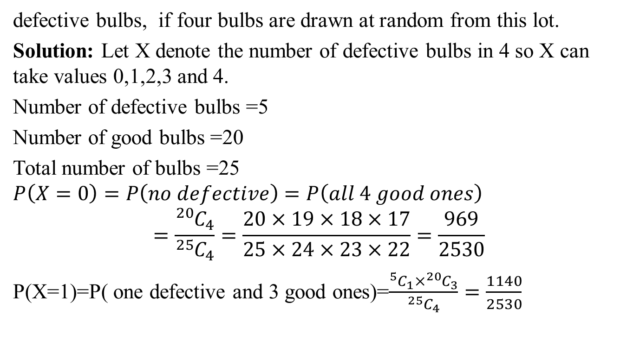
Probability Mass Function(CO3)
defective bulbs, if four bulbs are drawn at random from this lot.
Solution: Let X denote the number of defective bulbs in 4 so X can take values 0,1,2,3 and 4.
Number of defective bulbs =5
Number of good bulbs =20
Total number of bulbs =25
$$P\left(X=0\right)=P\left(no defective\right)=P\left(all 4 good ones\right)$$
$$=\frac{{}_{ }^{20}{C_{4}}}{{}_{ }^{25}{C_{4}}}=\frac{20×19×18×17}{25×24×23×22}=\frac{969}{2530}$$
P(X=1)=P( one defective and 3 good ones)=$\frac{{}_{ }^{5}{C_{1}}×{}_{ }^{20}{C_{3}}}{{}_{ }^{25}{C_{4}}}=\frac{1140}{2530}$

Slide 24
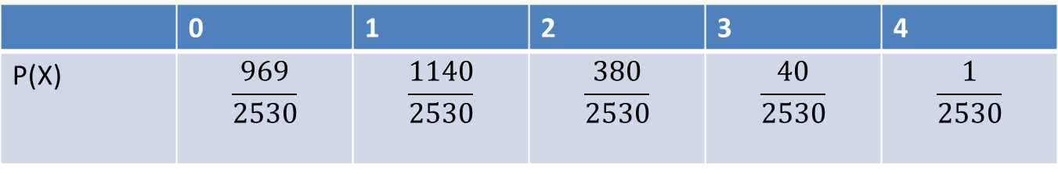

Probability Mass Function(CO3)
P(X=2)=P( 2 defective and 2 good ones)=$\frac{{}_{ }^{5}{C_{2}}×{}_{ }^{20}{C_{2}}}{{}_{ }^{25}{C_{4}}}=\frac{380}{2530}$
P(X=1)=P( 3 defective and 1 good ones)=$\frac{{}_{ }^{5}{C_{3}}×{}_{ }^{20}{C_{1}}}{{}_{ }^{25}{C_{4}}}=\frac{40}{2530}$
P(X=1)=P( all 4 defectives)=$\frac{{}_{ }^{5}{C_{4}}}{{}_{ }^{25}{C_{4}}}=\frac{1}{2530}$
Therefore probability distribution of the random variable X is

Slide 25
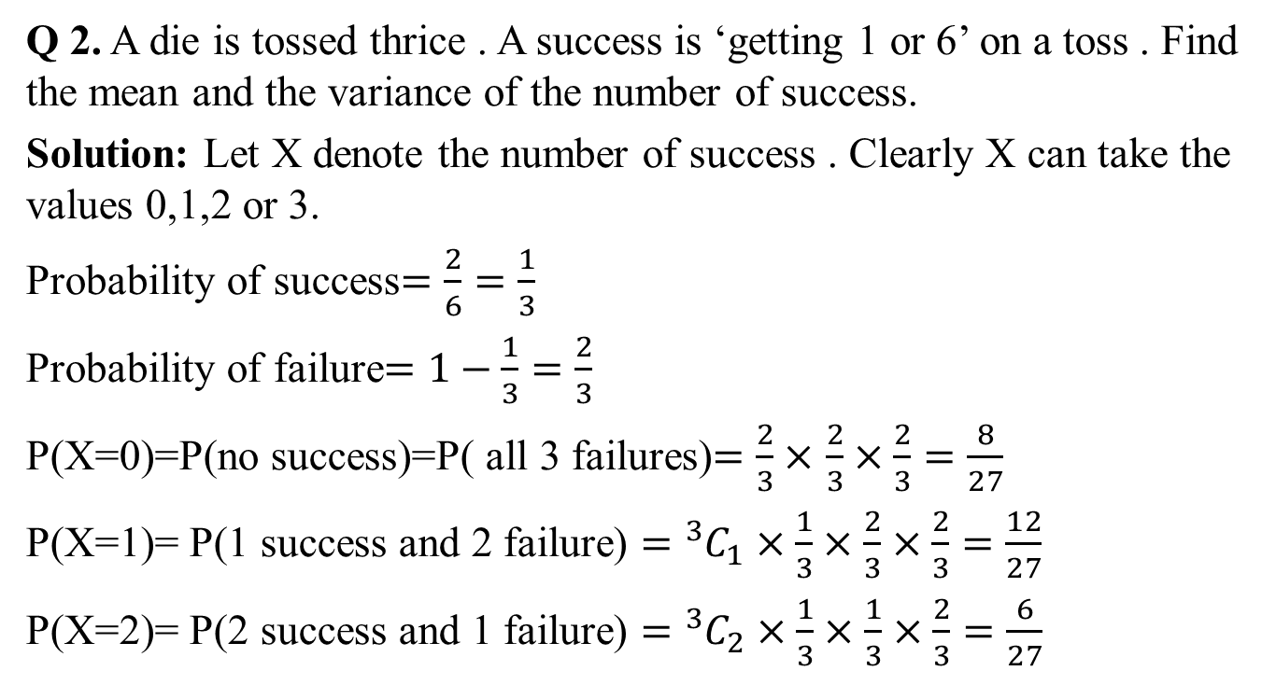
Probability Mass Function(CO3)
Q 2. A die is tossed thrice . A success is ‘getting 1 or 6’ on a toss . Find the mean and the variance of the number of success.
Solution: Let X denote the number of success . Clearly X can take the values 0,1,2 or 3.
Probability of success$=\frac{2}{6}=\frac{1}{3}$
Probability of failure$=1−\frac{1}{3}=\frac{2}{3}$
P(X=0)=P(no success)=P( all 3 failures)$=\frac{2}{3}×$ $\frac{2}{3}×\frac{2}{3}=\frac{8}{27}$
P(X=1)= P(1 success and 2 failure) $={}_{ }^{3}{C_{1}×}\frac{1}{3}×$ $\frac{2}{3}×\frac{2}{3}=\frac{12}{27}$
P(X=2)= P(2 success and 1 failure) $={}_{ }^{3}{C_{2}×}\frac{1}{3}×$ $\frac{1}{3}×\frac{2}{3}=\frac{6}{27}$

Slide 26
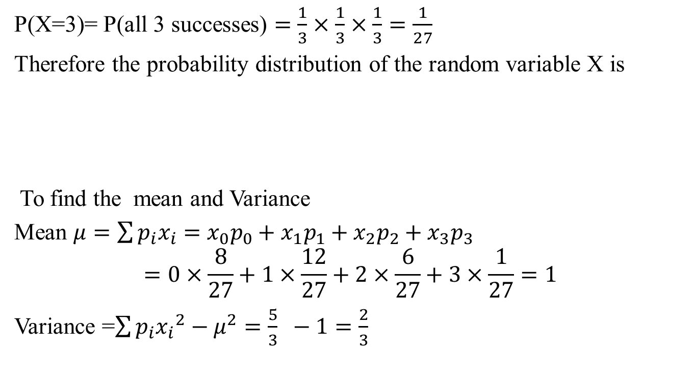
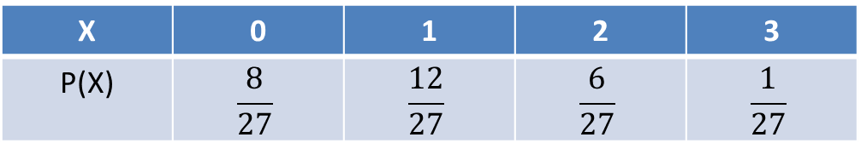
Probability Mass Function(CO3)
P(X=3)= P(all 3 successes) $=\frac{1}{3}×$ $\frac{1}{3}×\frac{1}{3}=\frac{1}{27}$
Therefore the probability distribution of the random variable X is
To find the mean and Variance
Mean $μ=\sum{p_{i}x_{i}=}$ ${x_{0}p_{0}+x}_{1}p_{1}+x_{2}p_{2}+x_{3}p_{3}$
$$=0×\frac{8}{27}+1×\frac{12}{27}+2×\frac{6}{27}+3×\frac{1}{27}=1$$
Variance =$\sum{p_{i}{x_{i}}_{ }^{2}−μ^{2}=\frac{5}{3} −1=\frac{2}{3} }$
X | 0 | 1 | 2 | 3
P(X) | $$\frac{8}{27}$$ | $$\frac{12}{27}$$ | $$\frac{6}{27}$$ | $$\frac{1}{27}$$

Slide 27
Continuous Random Variables(CO3)
Continuous Random Variable: Which variables can assume any value within interval is called continuous .
Example : The heights of a group of individuals, Weight of Students etc

Slide 28
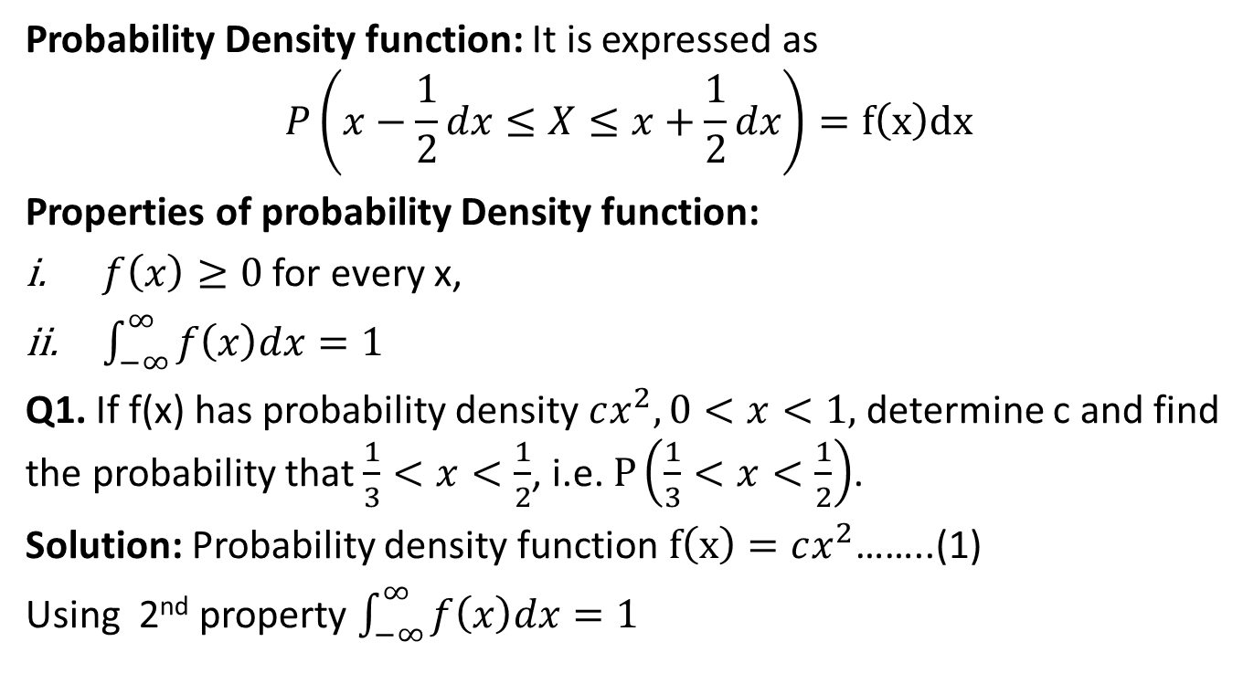
Probability Density function(CO3)
Probability Density function: It is expressed as
$$P\left(x−\frac{1}{2}dx≤X≤x+\frac{1}{2}dx\right)=f\left(x\right)dx$$
Properties of probability Density function:
$f\left(x\right)≥0$ for every x,
$\int_{−∞}^{∞}{f\left(x\right)dx=1}$
Q1. If f(x) has probability density $cx^{2},0<x<1,$ determine c and find the probability that $\frac{1}{3}<x<\frac{1}{2}$, i.e. $P\left(\frac{1}{3}<x<\frac{1}{2}\right)$.
Solution: Probability density function $f\left(x\right)=cx^{2}$……..(1)
Using 2nd property $\int_{−∞}^{∞}{f\left(x\right)dx=1}$

Slide 29

Probability Density function(CO3)
We have
$\int_{0}^{1}{cx^{2}=1}$
$$⟹\frac{1}{3}{{\left[cx^{3}\right]}^{1}}_{0}^{ }=1$$
$$⟹c=3$$
$$P\left(\frac{1}{3}<x<\frac{1}{2}\right)=\int_{1/3}^{1/2}{3x^{2}=\frac{19}{216}}$$

Slide 30
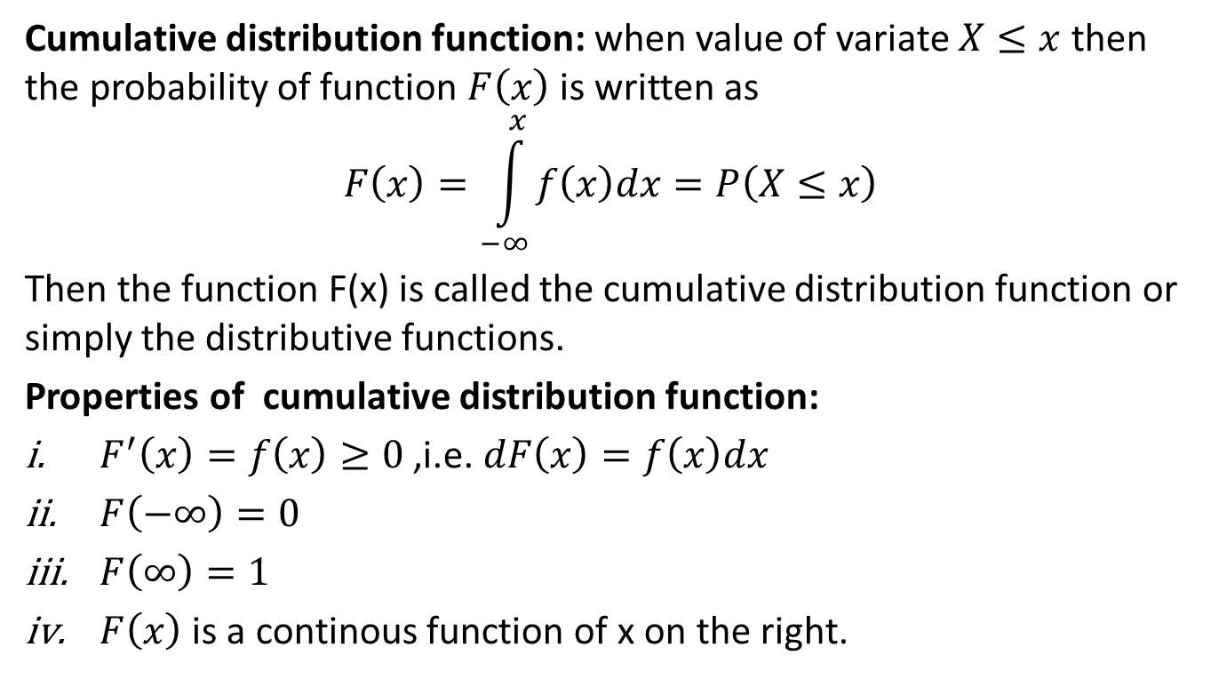
Cumulative distribution function(CO3)
Cumulative distribution function: when value of variate $X≤x$then the probability of function $F\left(x\right)$ is written as
$$F\left(x\right)=\int_{−∞}^{x}{f\left(x\right)dx}=P\left(X≤x\right)$$
Then the function F(x) is called the cumulative distribution function or simply the distributive functions.
Properties of cumulative distribution function:
$F^{′}\left(x\right)=f\left(x\right)≥0$ ,i.e. $dF\left(x\right)=f\left(x\right)dx$
$F\left(−∞\right)=0$
$F\left(∞\right)=1$
$F\left(x\right)$ is a continous function of x on the right.

Slide 31
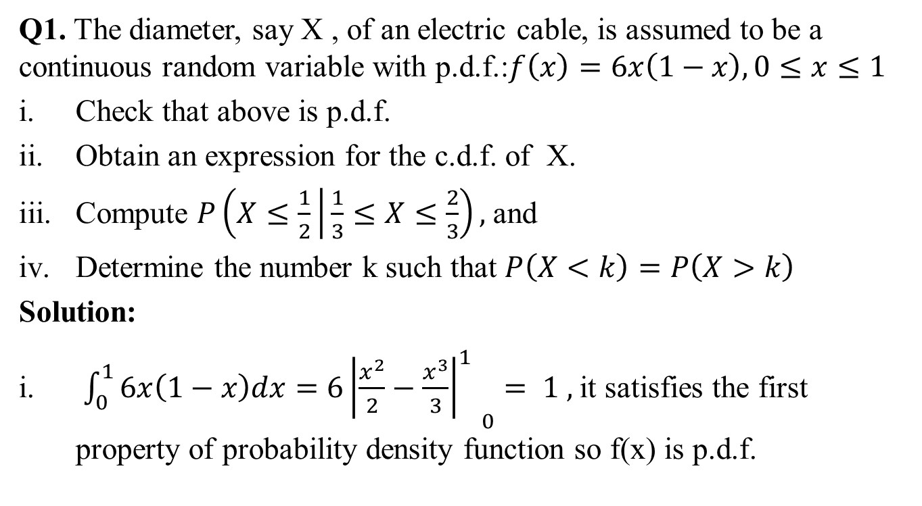
Cumulative distribution function(CO3)
Q1. The diameter, say X , of an electric cable, is assumed to be a continuous random variable with p.d.f.:$f\left(x\right)=6x\left(1−x\right),0≤x≤1$
Check that above is p.d.f.
Obtain an expression for the c.d.f. of X.
Compute $P\left(X≤\frac{1}{2} | \frac{1}{3}≤X≤\frac{2}{3}\right),$and
Determine the number k such that $P\left(X<k\right)=P\left(X>k\right)$
Solution:
$\int_{0}^{1}{6x\left(1−x\right)dx=6{{\left|\frac{x^{2}}{2}−\frac{x^{3}}{3}\right|}_{}^{1}}_{0}}= 1 ,$it satisfies the first property of probability density function so f(x) is p.d.f.

Slide 32
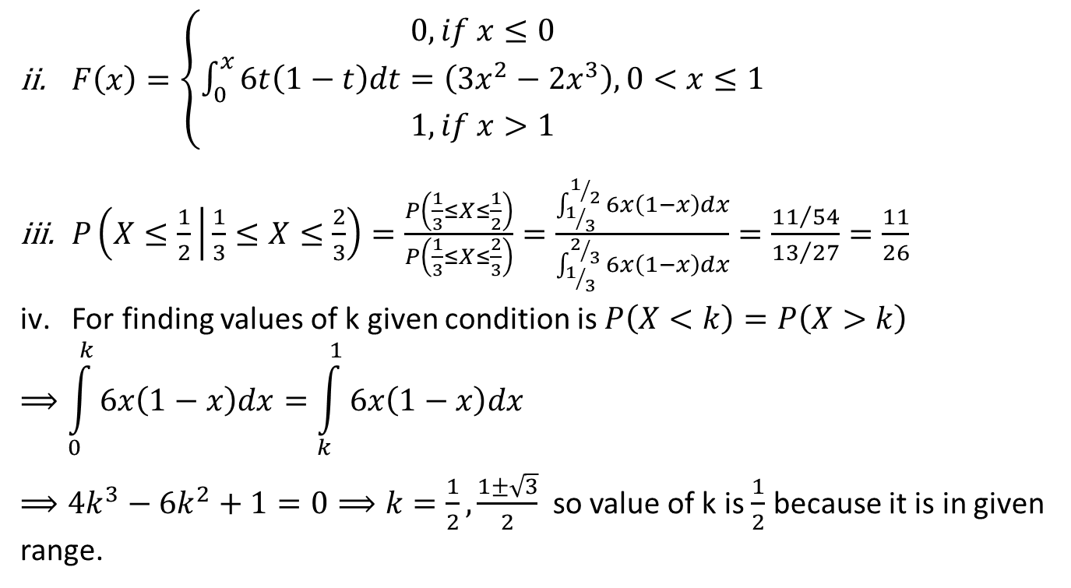
Cumulative distribution function(CO3)
$F\left(x\right)=\left\{\begin{matrix}0, if x≤0 \\ \int_{0}^{x}{6t\left(1−t\right)dt=\left(3x^{2}−2x^{3}\right),0<x≤1} \\ 1, if x>1\end{matrix}\right.$
$P\left(X≤\frac{1}{2} | \frac{1}{3}≤X≤\frac{2}{3}\right)=\frac{P\left(\frac{1}{3}≤X≤\frac{1}{2}\right)}{P\left(\frac{1}{3}≤X≤\frac{2}{3}\right)}=\frac{\int_{1/3}^{1/2}{6x\left(1−x\right)dx}}{\int_{1/3}^{2/3}{6x\left(1−x\right)dx}}=\frac{{11}/{54}}{{13}/{27}}=\frac{11}{26}$
For finding values of k given condition is $P\left(X<k\right)=P\left(X>k\right)$
$$⟹\int_{0}^{k}{6x\left(1−x\right)dx=\int_{k}^{1}{6x\left(1−x\right)dx}}$$
$⟹4k^{3}−6k^{2}+1=0⟹k=\frac{1}{2},\frac{1±\sqrt{3}}{2}$ so value of k is $\frac{1}{2}$ because it is in given range.

Slide 33
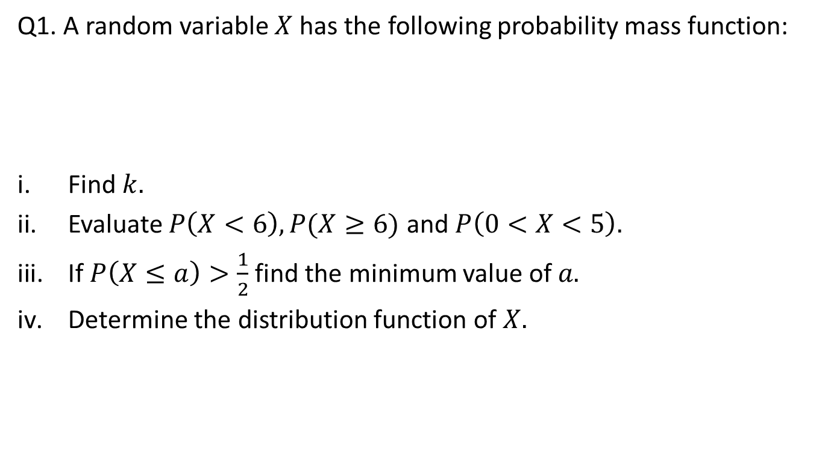
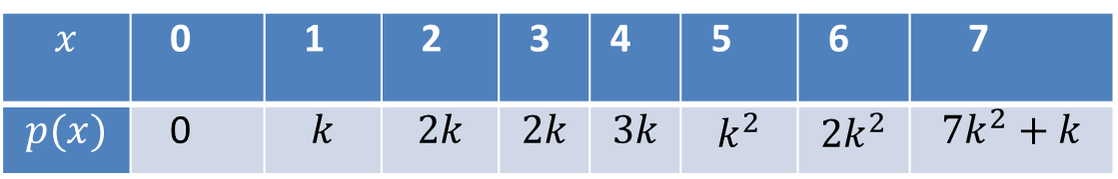
Daily Quiz(CO3)
Q1. A random variable $X$ has the following probability mass function:
Find $k.$
Evaluate $P\left(X<6\right),P(X≥6)$ and $P\left(0<X<5\right).$
If $P\left(X≤a\right)>\frac{1}{2}$ find the minimum value of $a.$
Determine the distribution function of $X.$
$$x$$ | 0 | 1 | 2 | 3 | 4 | 5 | 6 | 7
$$p(x)$$ | 0 | $$k$$ | $$2k$$ | $$2k$$ | $$3k$$ | $$k^{2}$$ | $${2k}^{2}$$ | $${7k}^{2}+k$$

Slide 34
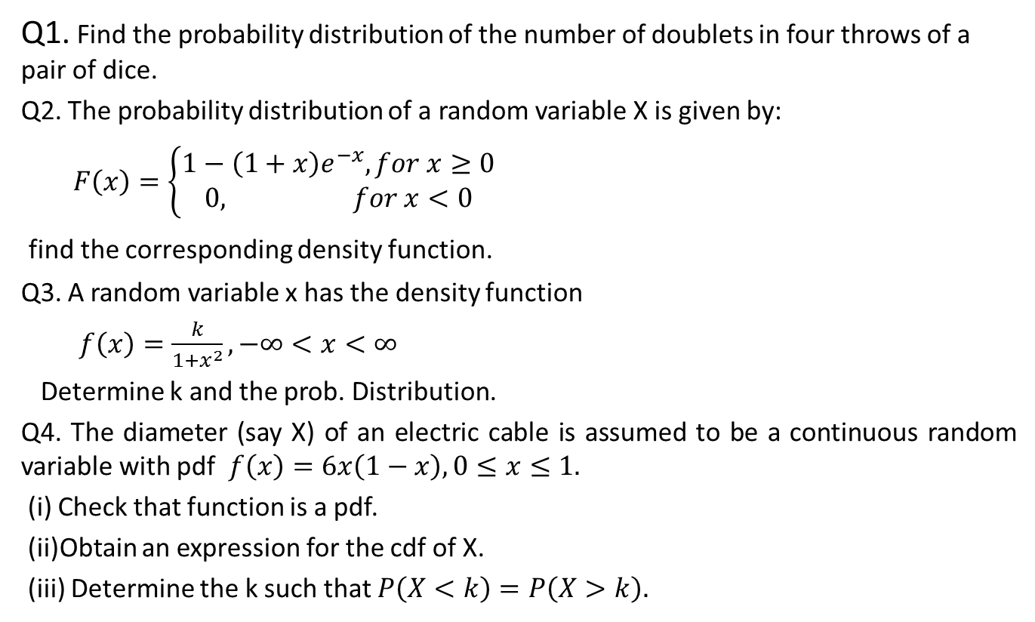
Weekly assignment(CO3)
Q1. Find the probability distribution of the number of doublets in four throws of a pair of dice.
Q2. The probability distribution of a random variable X is given by:
$F\left(x\right)=\left\{\begin{aligned}1−\left(1+x\right)e^{−x}, for x≥0 \\ 0, for x<0\end{aligned}\right.$
find the corresponding density function.
Q3. A random variable x has the density function
$f\left(x\right)=\frac{k}{1+x^{2}}, −∞<x<∞$
Determine k and the prob. Distribution.
Q4. The diameter (say X) of an electric cable is assumed to be a continuous random variable with pdf $f\left(x\right)=6x\left(1−x\right), 0≤x≤1.$
(i) Check that function is a pdf.
(ii)Obtain an expression for the cdf of X.
(iii) Determine the k such that $P\left(X<k\right)=P\left(X>k\right).$

Slide 35
Prerequisite and Recap(CO3)
Random Variables for one dimension.
Probability Density function
Probability mass function

Slide 36
Topic Objective(CO3)
Multivariable random variable:
In this lecture, we will extend the idea of single random variable in to the two dimensional variables.
Based on this idea , we will discuss the joint probability distribution, Marginal probability distribution and Conditional probability distribution.

Slide 37
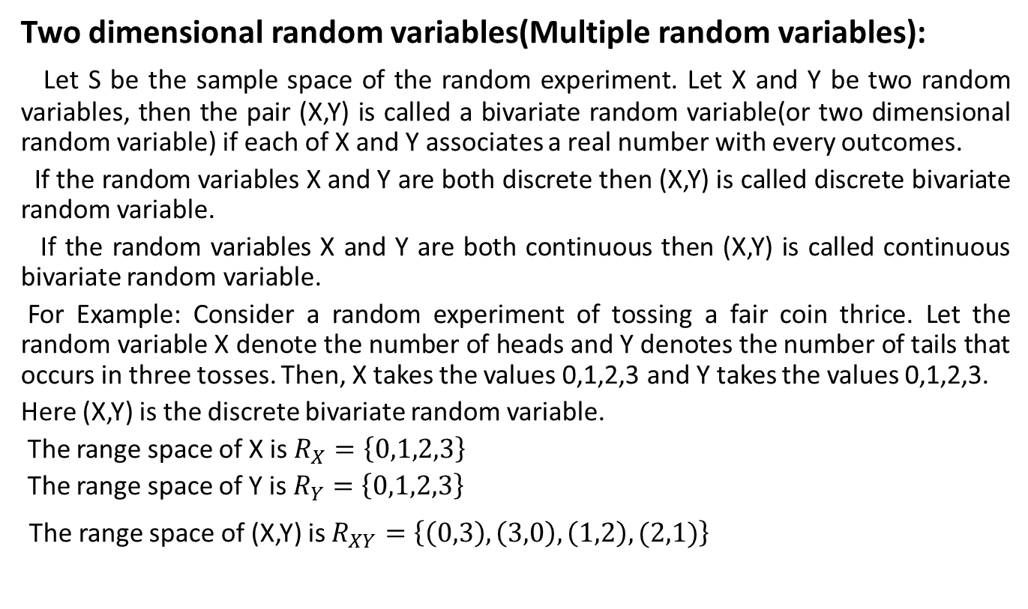
Multiple random variable(CO3)
Two dimensional random variables(Multiple random variables):
Let S be the sample space of the random experiment. Let X and Y be two random variables, then the pair (X,Y) is called a bivariate random variable(or two dimensional random variable) if each of X and Y associates a real number with every outcomes.
If the random variables X and Y are both discrete then (X,Y) is called discrete bivariate random variable.
If the random variables X and Y are both continuous then (X,Y) is called continuous bivariate random variable.
For Example: Consider a random experiment of tossing a fair coin thrice. Let the random variable X denote the number of heads and Y denotes the number of tails that occurs in three tosses. Then, X takes the values 0,1,2,3 and Y takes the values 0,1,2,3.
Here (X,Y) is the discrete bivariate random variable.
The range space of X is $R_{X}=\left\{0,1,2,3\right\}$
The range space of Y is $R_{Y}=\left\{0,1,2,3\right\}$
The range space of (X,Y) is $R_{XY}=\left\{\left(0,3\right),\left(3,0\right),\left(1,2\right),(2,1)\right\}$

Slide 38
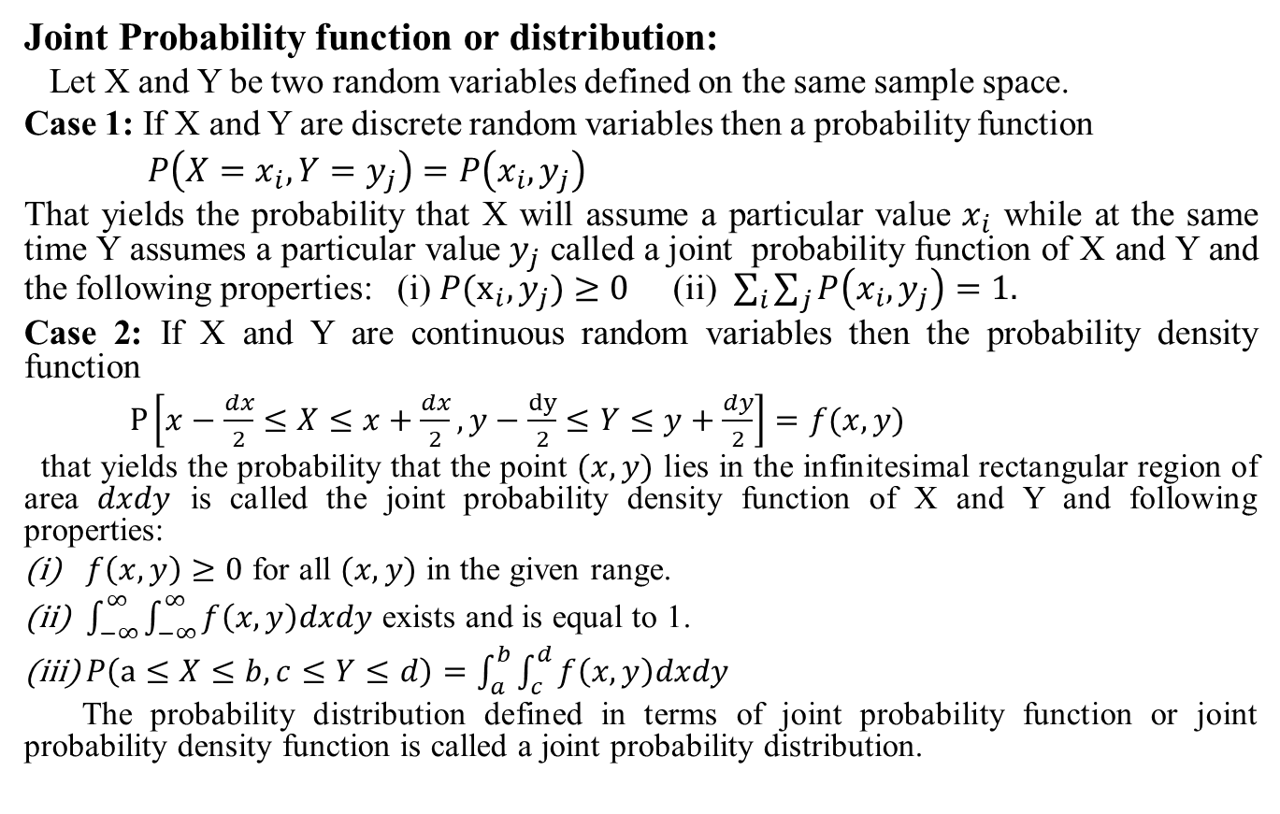
Joint Probability function(CO3)
Joint Probability function or distribution:
Let X and Y be two random variables defined on the same sample space.
Case 1: If X and Y are discrete random variables then a probability function
$P\left(X=x_{i}, Y=y_{j}\right)=P\left(x_{i}, y_{j}\right)$
That yields the probability that X will assume a particular value $x_{i}$ while at the same time Y assumes a particular value $y_{j}$ called a joint probability function of X and Y and the following properties: (i) $P(x_{i}, y_{j})≥0$ (ii) $\sum_{i}{\sum_{j}{P\left(x_{i}, y_{j}\right)=1.}}$
Case 2: If X and Y are continuous random variables then the probability density function
$P\left[x−\frac{dx}{2}≤X≤x+\frac{dx}{2}, y−\frac{dy}{2}≤Y≤y+\frac{dy}{2}\right]=f(x, y)$
that yields the probability that the point $(x, y)$ lies in the infinitesimal rectangular region of area $dxdy$ is called the joint probability density function of X and Y and following properties:
$f\left(x, y\right)≥0$ for all $(x, y)$ in the given range.
$\int_{−∞}^{∞}{\int_{−∞}^{∞}{f\left(x, y\right)dxdy}}$ exists and is equal to 1.
$P\left(a≤X≤b, c≤Y≤d\right)=\int_{a}^{b}{\int_{c}^{d}{f\left(x, y\right)dxdy}}$
The probability distribution defined in terms of joint probability function or joint probability density function is called a joint probability distribution.

Slide 39
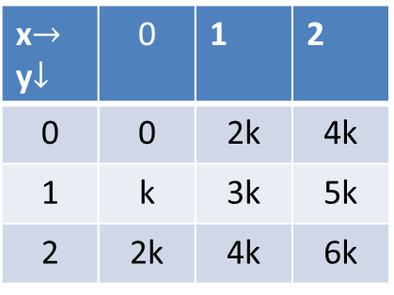

Joint Probability function(CO3)
x$→$ y$↓$ | 0 | 1 | 2
0 | 0 | 2k | 4k
1 | k | 3k | 5k
2 | 2k | 4k | 6k
Example: The joint density function of X and Y is given by
$P(x, y)=k\left(2x+y\right);x=0,1,2;y=0,1,2$
Find the value of k.
Solution: For joint density function, we have
$\sum_{x}{\sum_{y}{P\left(x, y\right)=1}}$
$⟹0+1k+2k+2k+3k+4k+4k+5k+6k=1$
$⟹27k=1$
$⟹k=\frac{1}{27}.$

Slide 40
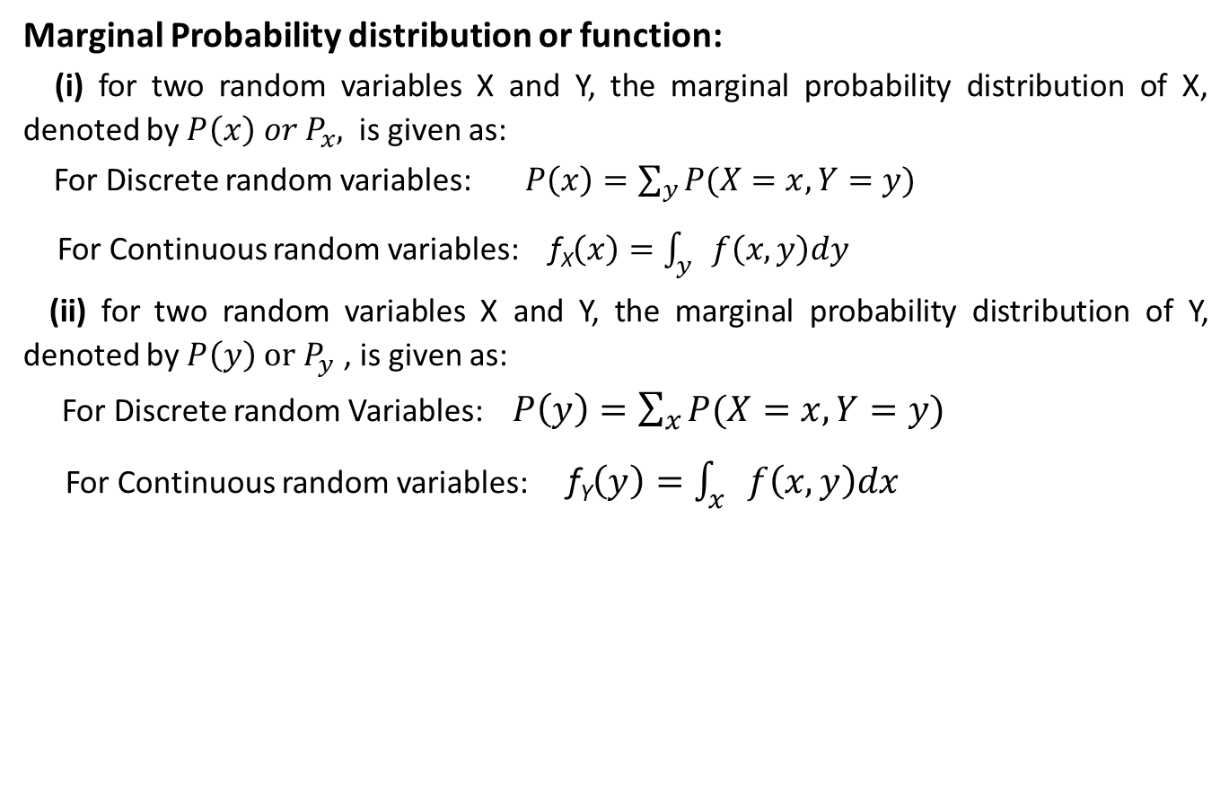
Marginal Probability distribution(CO3)
Marginal Probability distribution or function:
(i) for two random variables X and Y, the marginal probability distribution of X, denoted by $P\left(x\right) or P_{x},$ is given as:
For Discrete random variables: $P\left(x\right)=\sum_{y}{P(X=x, Y=y)}$
For Continuous random variables: f_{X}$\left(x\right)=\int_{y}{f\left(x, y\right)dy}$
(ii) for two random variables X and Y, the marginal probability distribution of Y, denoted by $P\left(y\right) or P_{y}$ , is given as:
For Discrete random Variables: $P\left(y\right)=\sum_{x}{P(X=x, Y=y)}$
For Continuous random variables: f_{Y}$\left(y\right)=\int_{x}{f\left(x,y\right)dx}$

Slide 41
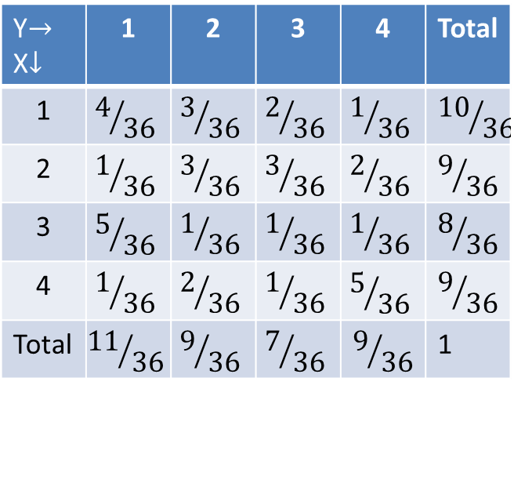
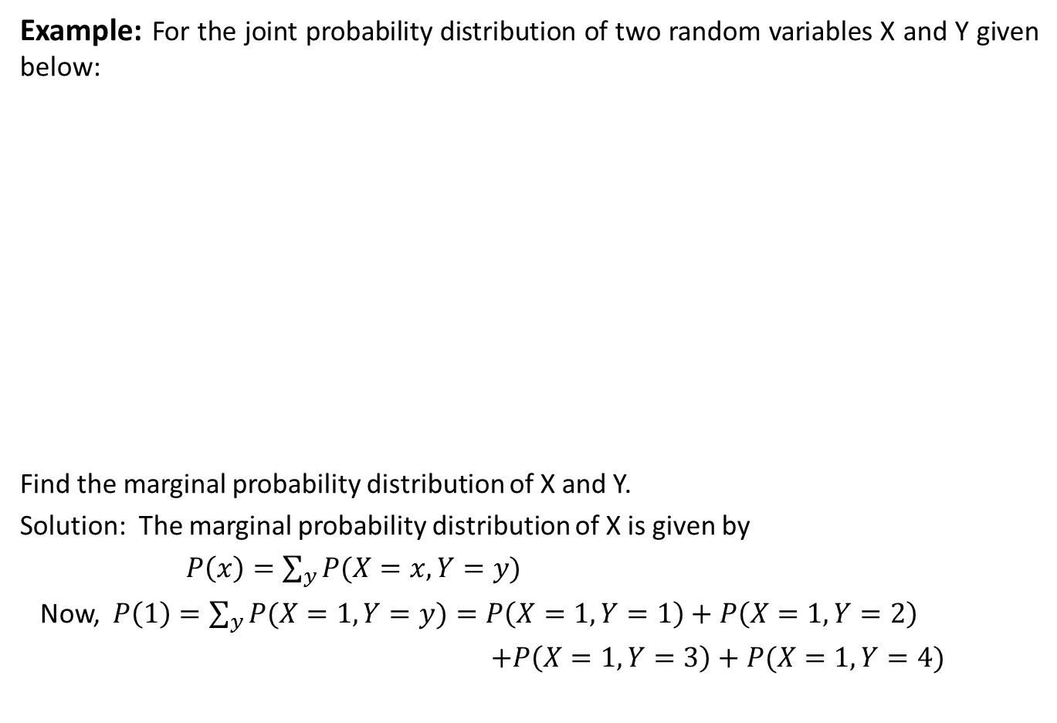
Marginal Probability distribution(CO3)
Example: For the joint probability distribution of two random variables X and Y given below:
Find the marginal probability distribution of X and Y.
Solution: The marginal probability distribution of X is given by
$P\left(x\right)=\sum_{y}{P(X=x, Y=y)}$
Now, $P\left(1\right)=\sum_{y}{P(X=1, Y=y)}=P\left(X=1,Y=1\right)+P\left(X=1,Y=2\right)$
$+P\left(X=1,Y=3\right)+P(X=1,Y=4)$
Y$→$ X$↓$ | 1 | 2 | 3 | 4 | Total
1 | $$4/{36}$$ | $$3/{36}$$ | $$2/{36}$$ | $$1/{36}$$ | $${10}/{36}$$
2 | $$1/{36}$$ | $$3/{36}$$ | $$3/{36}$$ | $$2/{36}$$ | $$9/{36}$$
3 | $$5/{36}$$ | $$1/{36}$$ | $$1/{36}$$ | $$1/{36}$$ | $$8/{36}$$
4 | $$1/{36}$$ | $$2/{36}$$ | $$1/{36}$$ | $$5/{36}$$ | $$9/{36}$$
Total | $${11}/{36}$$ | $$9/{36}$$ | $$7/{36}$$ | $$9/{36}$$ | 1

Slide 42
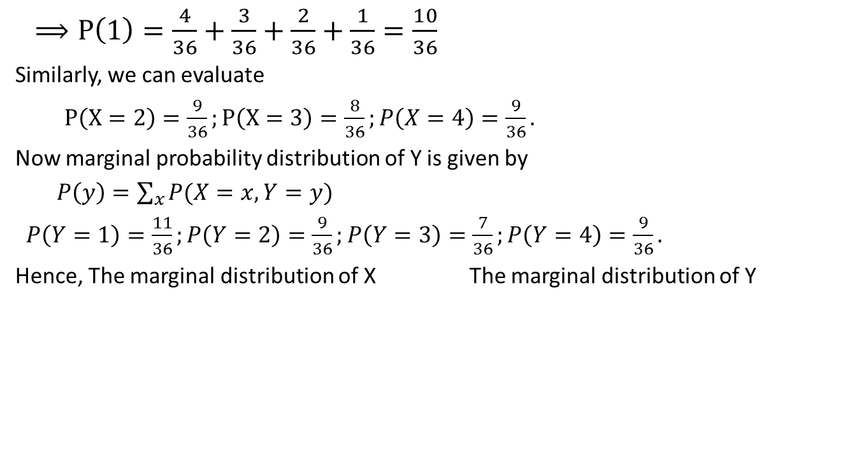
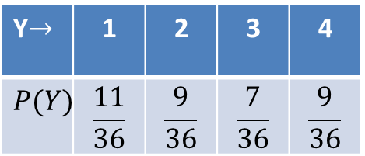
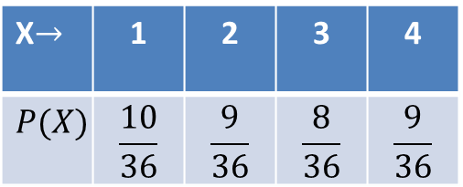
Marginal Probability distribution(CO3)
$⟹P\left(1\right)=\frac{4}{36}+\frac{3}{36}+\frac{2}{36}+\frac{1}{36}=\frac{10}{36}$
Similarly, we can evaluate
$P\left(X=2\right)=\frac{9}{36};P\left(X=3\right)=\frac{8}{36};P\left(X=4\right)=\frac{9}{36}.$
Now marginal probability distribution of Y is given by
$P\left(y\right)=\sum_{x}{P(X=x, Y=y)}$
$P\left(Y=1\right)=\frac{11}{36};P\left(Y=2\right)=\frac{9}{36};P\left(Y=3\right)=\frac{7}{36};P\left(Y=4\right)=\frac{9}{36}.$
Hence, The marginal distribution of X The marginal distribution of Y
X$→$ | 1 | 2 | 3 | 4
$$P(X)$$ | $$\frac{10}{36}$$ | $$\frac{9}{36}$$ | $$\frac{8}{36}$$ | $$\frac{9}{36}$$
Y$→$ | 1 | 2 | 3 | 4
$$P(Y)$$ | $$\frac{11}{36}$$ | $$\frac{9}{36}$$ | $$\frac{7}{36}$$ | $$\frac{9}{36}$$

Slide 43
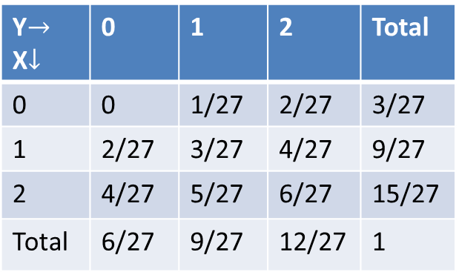
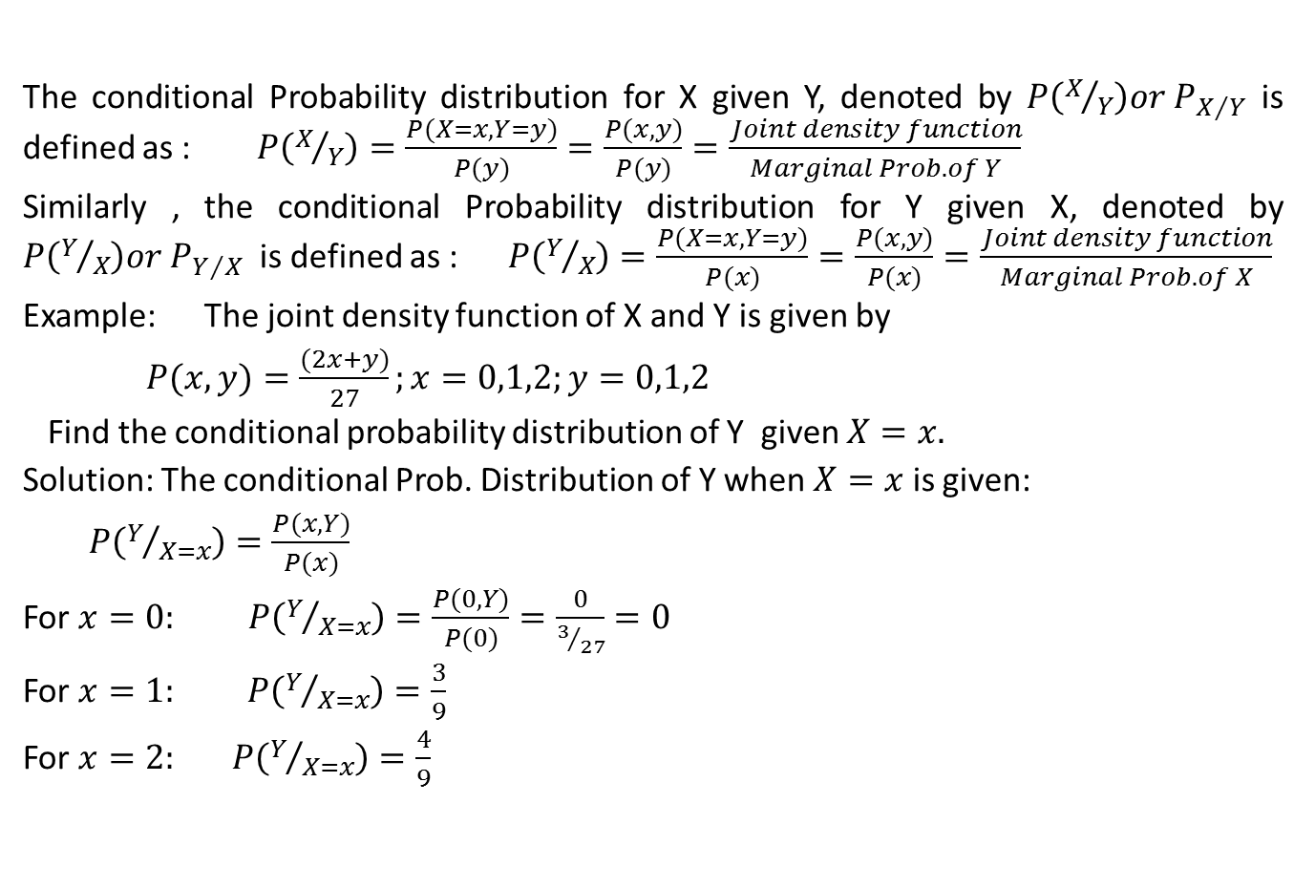
Conditional Probability distribution(CO3)
The conditional Probability distribution for X given Y, denoted by $P\left(X/Y\right)or P_{X/Y}$ is defined as : $P\left(X/Y\right)=\frac{P(X=x,Y=y)}{P(y)}=\frac{P(x,y)}{P(y)}=\frac{Joint density function}{Marginal Prob. of Y}$
Similarly , the conditional Probability distribution for Y given X, denoted by $P\left(Y/X\right)or P_{Y/X}$ is defined as : $P\left(Y/X\right)=\frac{P(X=x,Y=y)}{P(x)}=\frac{P(x,y)}{P(x)}=\frac{Joint density function}{Marginal Prob. of X}$
Example: The joint density function of X and Y is given by
$P(x, y)=\frac{(2x+y)}{27};x=0,1,2;y=0,1,2$
Find the conditional probability distribution of Y given $X=x.$
Solution: The conditional Prob. Distribution of Y when $X=x$ is given:
$P\left(Y/{X=x}\right)=\frac{P(x,Y)}{P(x)}$
For $x=0:$ $P\left(Y/{X=x}\right)=\frac{P(0,Y)}{P(0)}=\frac{0}{3/{27}}=0$
For $x=1:$ $P\left(Y/{X=x}\right)=\frac{3}{9}$
For $x=2:$ $P\left(Y/{X=x}\right)=\frac{4}{9}$
Y$→$ X$↓$ | 0 | 1 | 2 | Total
0 | 0 | 1/27 | 2/27 | 3/27
1 | 2/27 | 3/27 | 4/27 | 9/27
2 | 4/27 | 5/27 | 6/27 | 15/27
Total | 6/27 | 9/27 | 12/27 | 1

Slide 44
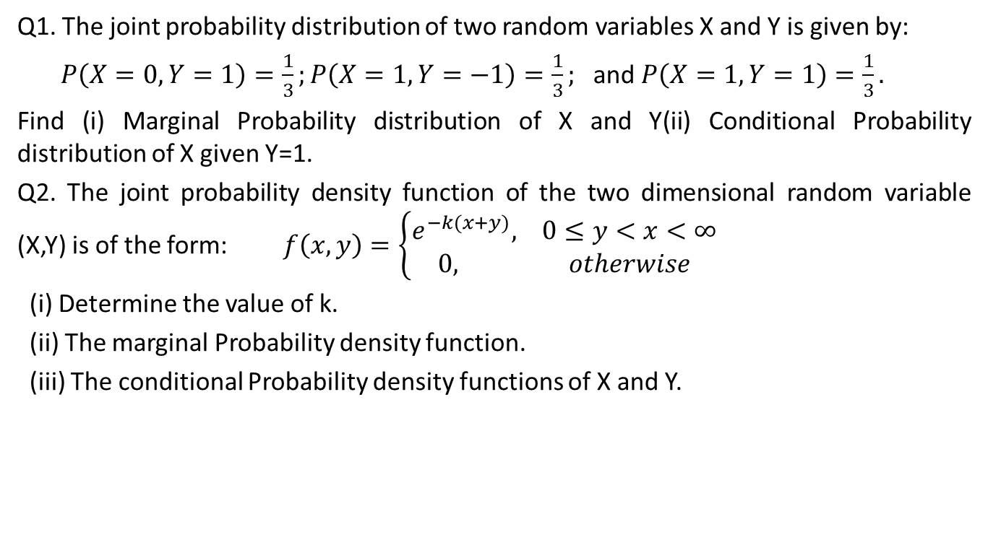
Daily Quiz(CO3)
Q1. The joint probability distribution of two random variables X and Y is given by:
$P\left(X=0,Y=1\right)=\frac{1}{3};P\left(X=1,Y=−1\right)=\frac{1}{3};$ and $P\left(X=1,Y=1\right)=\frac{1}{3}.$
Find (i) Marginal Probability distribution of X and Y(ii) Conditional Probability distribution of X given Y=1.
Q2. The joint probability density function of the two dimensional random variable (X,Y) is of the form: $f\left(x,y\right)=\left\{\begin{aligned}e^{−k(x+y)}, 0≤y<x<∞ \\ 0, otherwise\end{aligned}\right.$
(i) Determine the value of k.
(ii) The marginal Probability density function.
(iii) The conditional Probability density functions of X and Y.

Slide 45
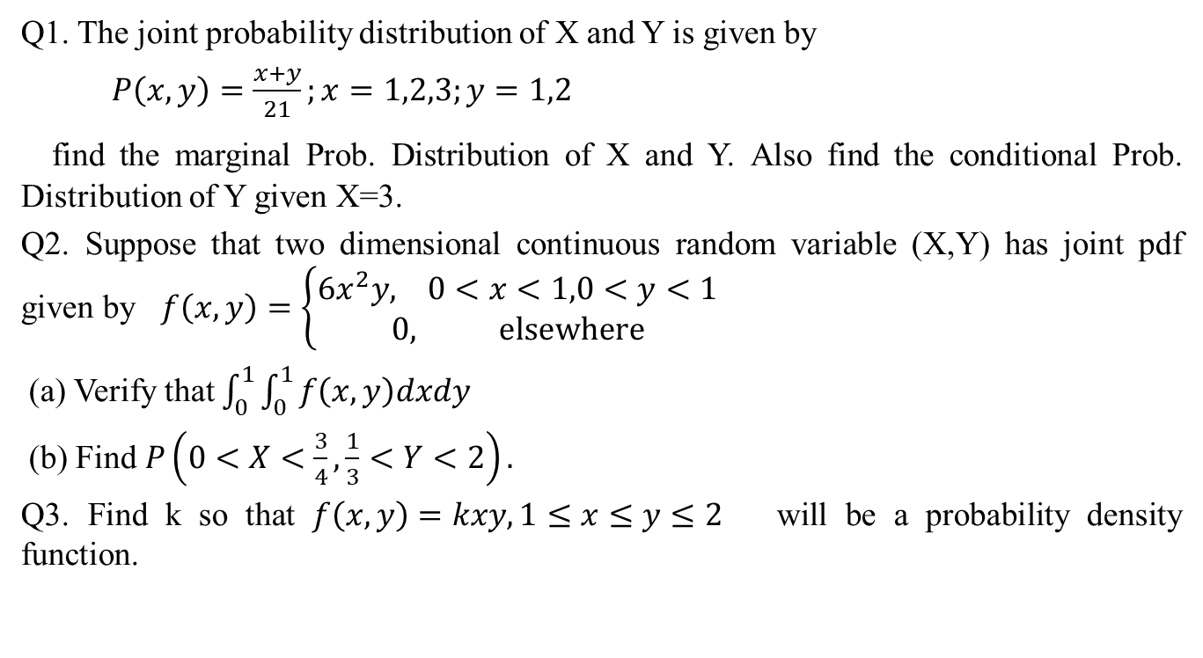
Weekly Assignment(CO3)
Q1. The joint probability distribution of X and Y is given by
$P\left(x,y\right)=\frac{x+y}{21};x=1,2,3;y=1,2$
find the marginal Prob. Distribution of X and Y. Also find the conditional Prob. Distribution of Y given X=3.
Q2. Suppose that two dimensional continuous random variable (X,Y) has joint pdf given by $f\left(x,y\right)=\left\{\begin{aligned}6x^{2}y, 0<x<1,0<y<1 \\ 0, elsewhere\end{aligned}\right.$
(a) Verify that $\int_{0}^{1}{\int_{0}^{1}{f\left(x,y\right)dxdy}}$
(b) Find $P\left(0<X<\frac{3}{4},\frac{1}{3}<Y<2\right).$
Q3. Find k so that $f\left(x,y\right)=kxy, 1≤x≤y≤2$ will be a probability density function.

Slide 46

Weekly Assignment(CO3)
Q4. A two dimensional random variable (X,Y) has a bivariate distribution given by:
$P\left(X=x,Y=y\right)=\frac{x^{2}+y}{32},$ for $x=0,1,2,3$ and $y=0,1.$ Find the marginal distribution of X and Y.

Slide 47
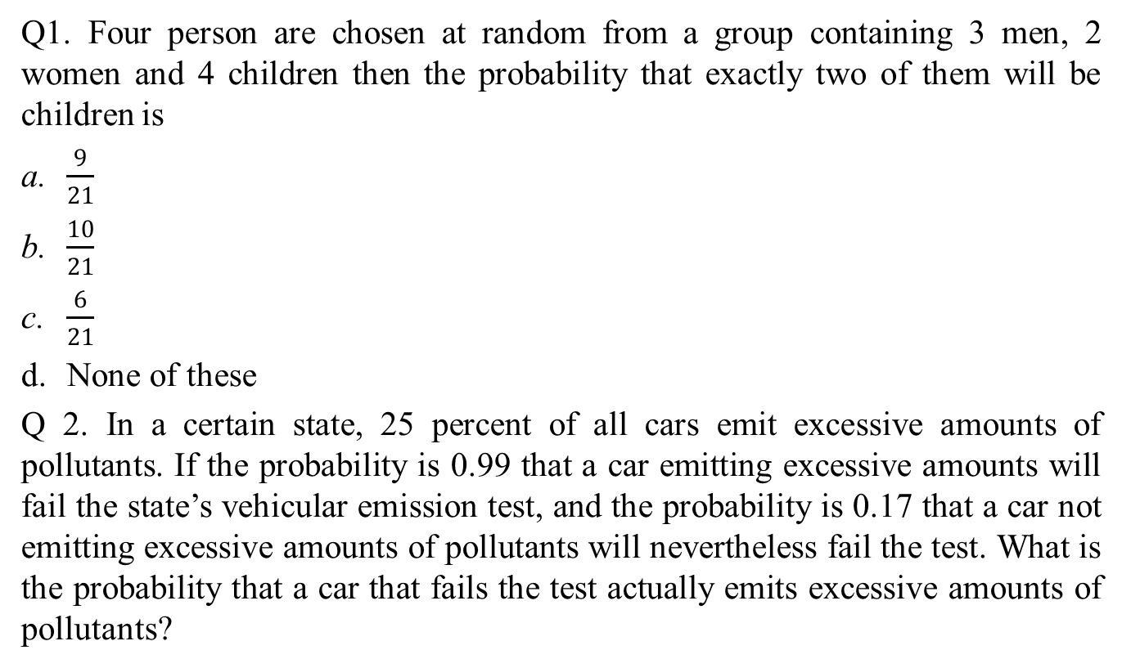
MCQ (CO3)
Q1. Four person are chosen at random from a group containing 3 men, 2 women and 4 children then the probability that exactly two of them will be children is
$\frac{9}{21}$
$\frac{10}{21}$
$\frac{6}{21}$
None of these
Q 2. In a certain state, 25 percent of all cars emit excessive amounts of pollutants. If the probability is 0.99 that a car emitting excessive amounts will fail the state’s vehicular emission test, and the probability is 0.17 that a car not emitting excessive amounts of pollutants will nevertheless fail the test. What is the probability that a car that fails the test actually emits excessive amounts of pollutants?

Slide 48
MCQ (CO3)
0.60
0.70
0.66
None of these
Q3. A can hit a target 3 times in 5 shots, B 2 times in 5 shots and C 3 times in 4 shots. All of them fire one shot each simultaneously at the target. What is the probability that at least two shots hit-
0.60
0.62
0.63
0.50
Unit II

Slide 49
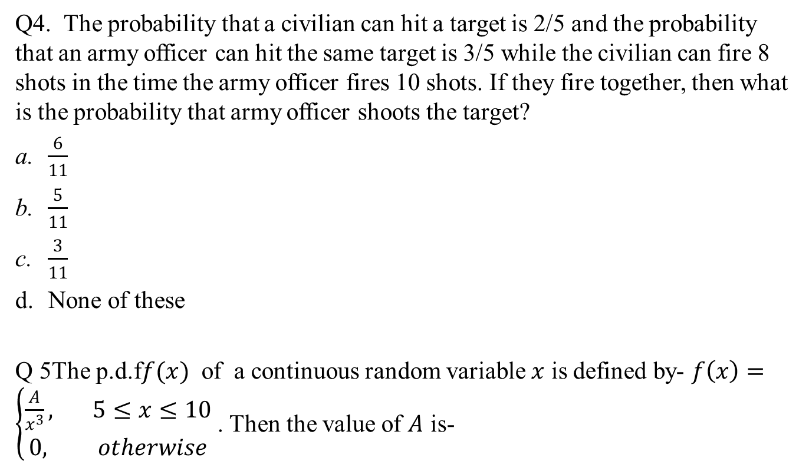
MCQ (CO3)
Q4. The probability that a civilian can hit a target is 2/5 and the probability that an army officer can hit the same target is 3/5 while the civilian can fire 8 shots in the time the army officer fires 10 shots. If they fire together, then what is the probability that army officer shoots the target?
$\frac{6}{11}$
$\frac{5}{11}$
$\frac{3}{11}$
None of these
Q 5The p.d.f$f(x)$ of a continuous random variable $x$ is defined by- $f\left(x\right)=\left\{\begin{aligned}\frac{A}{x^{3}}, 5≤x≤10 \\ 0, otherwise\end{aligned}\right.$ . Then the value of $A$ is-

Slide 50

MCQ (CO3)
$\frac{100}{3}$
$\frac{200}{3}$
$\frac{50}{3}$
None of these

Slide 51
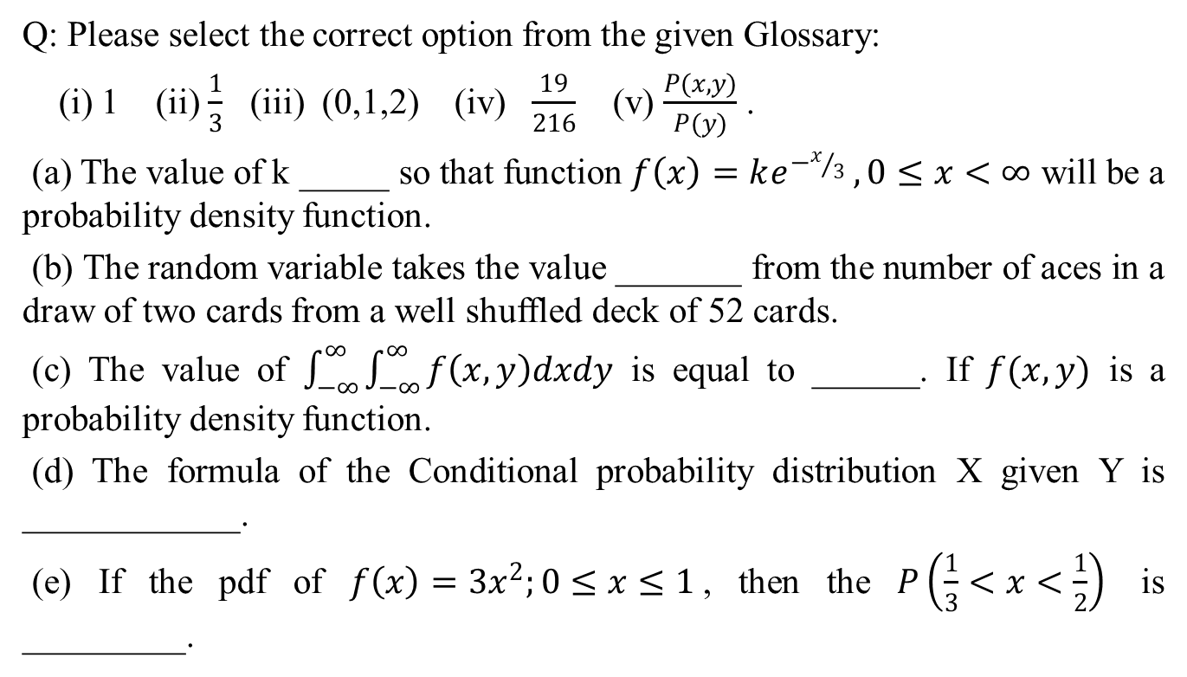
Glossary Questions (CO3)
Q: Please select the correct option from the given Glossary:
(i) 1 (ii) $\frac{1}{3}$ (iii) (0,1,2) (iv) $\frac{19}{216}$ (v) $\frac{P(x,y)}{P(y)}$ .
(a) The value of k _____ so that function $f\left(x\right)=ke^{−x/3} ,0≤x<∞$ will be a probability density function.
(b) The random variable takes the value _______ from the number of aces in a draw of two cards from a well shuffled deck of 52 cards.
(c) The value of $\int_{−∞}^{∞}{\int_{−∞}^{∞}{f\left(x,y\right)dxdy}}$ is equal to ______. If $f(x,y)$ is a probability density function.
(d) The formula of the Conditional probability distribution X given Y is ____________.
(e) If the pdf of $f\left(x\right)=3x^{2};0≤x≤1$, then the $P\left(\frac{1}{3}<x<\frac{1}{2}\right)$ is _________.

Slide 52

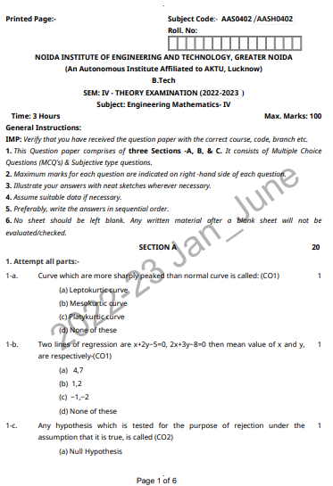
Previous Question Paper

Slide 53
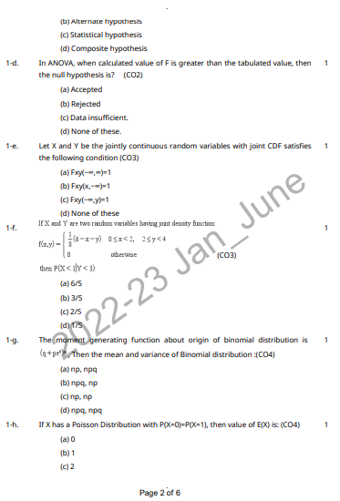
Previous Question Paper

Slide 54
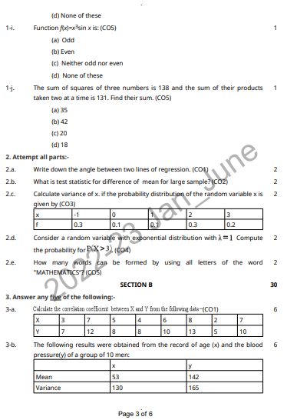
Previous Question Paper

Slide 55
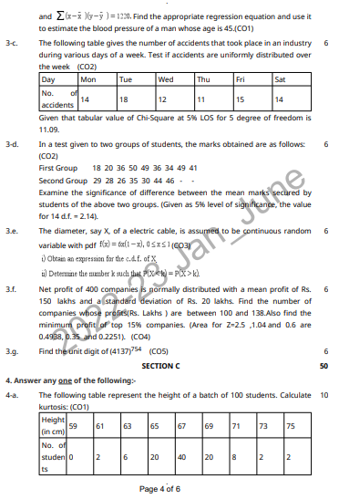
Previous Question Paper

Slide 56
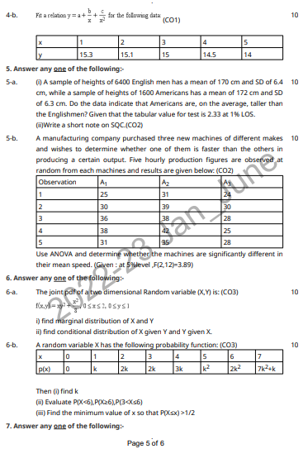
Previous Question Paper

Slide 57
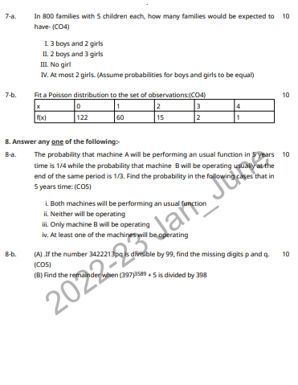
Previous Question Paper

Slide 58
Old Question Papers
First Sessional Set-1 (CSE,IT,CS,ECE,IOT).docx
Second Sessional Set-2 (CSE,IT,CS,ECE,IOT).docx
Maths IV PUT.docx
Maths IV final paper_2022.pdf

Slide 59
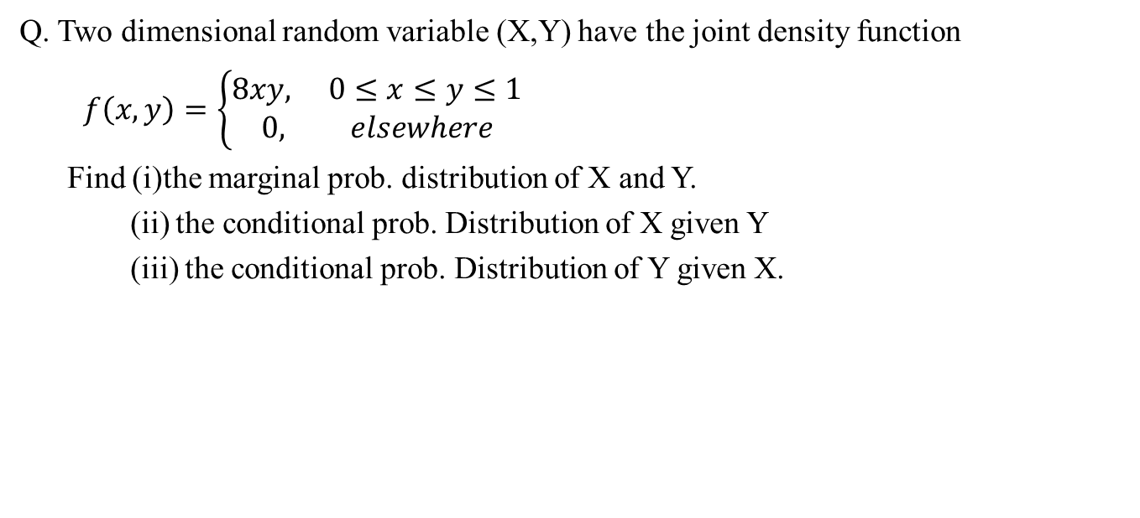
Expected Question for University
Exam(CO3)
Q. Two dimensional random variable (X,Y) have the joint density function
$f\left(x,y\right)=\left\{\begin{aligned}8xy, 0≤x≤y≤1 \\ 0, elsewhere\end{aligned}\right.$
Find (i)the marginal prob. distribution of X and Y.
(ii) the conditional prob. Distribution of X given Y
(iii) the conditional prob. Distribution of Y given X.

Slide 60
Thank You

